Slide 1
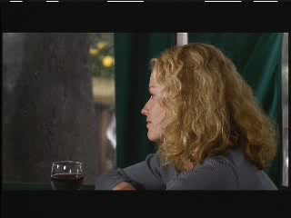
Deconstructing Harry (1997)

Slide 2
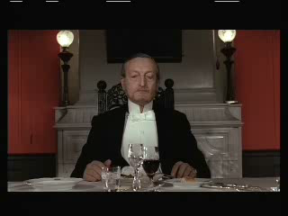
Cries and Whispers (1972)

Slide 3
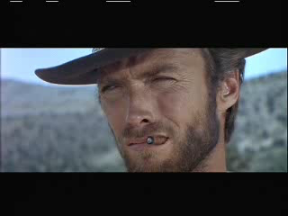
The Good, the Bad, and the Ugly (1966)

