Slide 1
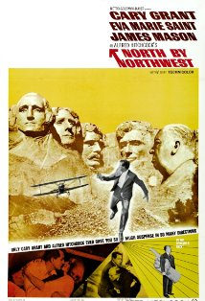
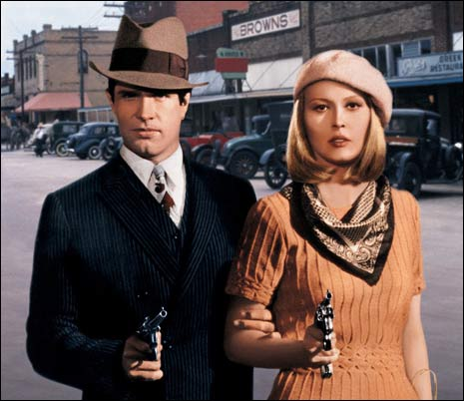
Editing
Bonnie & Clyde (1967)
North by Northwest (1959)

Slide 2
EDITING-The work of splicing together shots to assemble the finished film
Post-production
Considered by filmmakers as the most important step in creating the look or shape of a film

Slide 3
Editor’s responsibilities
Selects the best shots
Puts them in order
Arranges/connects the shots using variety of optical transitions.
Works with director, producer, cinematographer.

Slide 4
Editing Terms
Rough cut-working portion of film that eliminates unusable footage such as performance and technical errors.
Final cut-assembles rough cut in scene/sequence order; refined, pruned and polished

Slide 5
Editing types
Linear editing (pre-1990s)-moves through footage sequentially on celluloid. Editor has a more intimate relationship with footage
Non-linear editing (computer/digital age)-computer based, stored digitally, ability to move anywhere, anytime throughout footage. Has led to faster and more dynamic editing

Slide 6
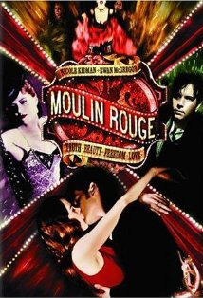
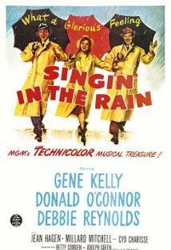
Compare editing styles
Singin’ in the Rain (1952)
Moulin Rouge (2001)

Slide 7
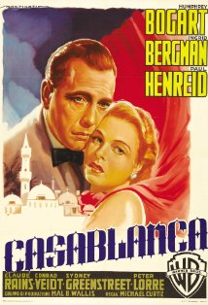
Visual Transitions Transition codes used to establish relation of time and place in a story
Casablanca (1942)

Slide 8
Straight Cut Complete and instantaneous shift of one image to another CODE: time and place specified

Slide 9
Dissolve-gradual transition fading out the current shot then fading in the new shot (a brief moment of superimposition). CODE: A shift to another location or a few hours later.

Slide 10
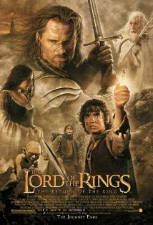
Fade-end of a shot fading out to an empty screen (usually black); brief pause; fade in introduces the next shot. CODE: Substantial shift in time.
The Lord of the Rings: The Return of the King (2003)

Slide 11
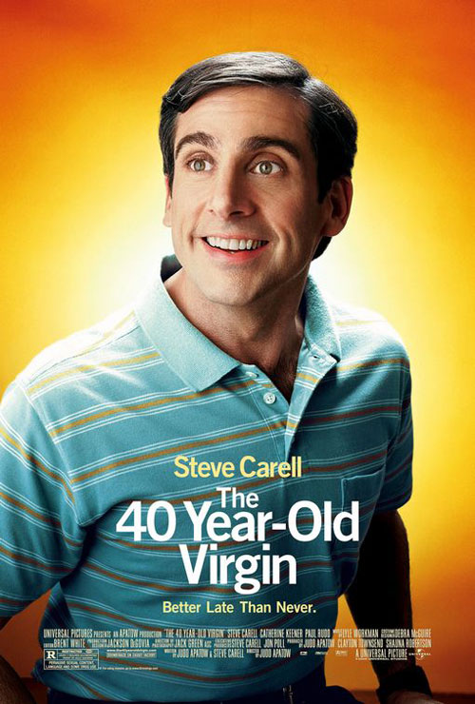
Other Visual Transitions

Slide 12
CUT-IN, CUT AWAY-An instantaneous shift from a distant framing to a closer view of some portion of the same space, and vice versa.

Slide 13
Iris-circle in middle of screen used to shift or change scene of focus; very old school

Slide 14
THE WIPE-A solid line will travel across the screen, sometimes vertically, sometimes horizontally. As it moves, it pushes one shot off the screen to reveal another. Aggressive, highly visible form of edit, unlike the fade or dissolve.

Slide 15
Jump Cut-Leaving a gap (i.e., leaving out frames) in an otherwise continuous shot. The gap will make the picture "jump.“ Can make a scene go faster or create a rough, jagged rhythm.

Slide 16
FUNCTIONS OF EDITING Editor, with direct involvement of director, combines shots to create narrative and expressive effects
Continuity
Dramatic Focus
Creating tempo and mood
Narration and point-of-view

Slide 17
1. Continuity
story and images must move along in an orderly manner
editors join shots to emphasize the relationship of continuity and orderliness between them
controls the character’s look, movement, etc. to maintain continuity

Slide 18
2. Dramatic Focus
Footage is cut to emphasize dramatic focus of the scene
The editor can improve an actor’s performance by deleting and joining shots
To find a dramatic focus the editor may
create scenes that did not exist in the
script

Slide 19
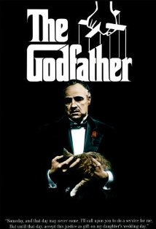
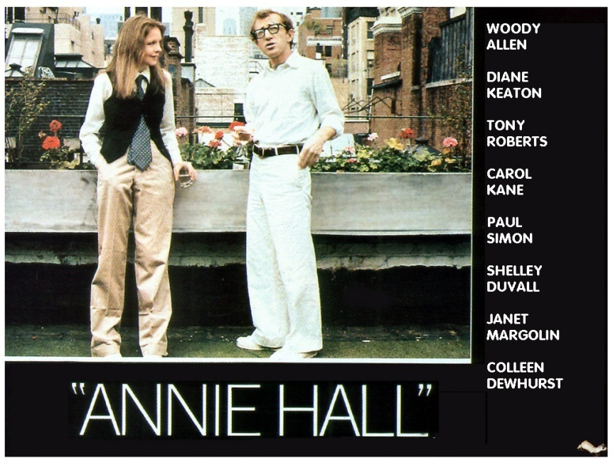
Annie Hall (1977)
The Godfather (1972)

Slide 20
3. Creating Tempo and Mood
By varying lengths of shots the editor establishes rhythm, tempo and pacing
-brief shots=fast pace
-longer shots=fuller, more measured, longer pace
-length of shots should never remain constant
-action and horror genre use fast editing to create suspense

Slide 21
4. narration/point of view
Editing allows filmmakers to control the flow of information or the way a scene’s story information is conveyed to the viewer

Slide 22
Continuity Editing Codes
Master shot-shows spatial layout of scene, all characters, position in relation to each other. Typically filmed first then director goes back to scene to film a multitude of shots.

Slide 23
2. Matched cut-matches part of the master shot composition only closer
3. Eyeline match-establishes characters are looking at each other and that the space they inhabit are matched; matches angles, positions, etc. of master shot
4. Shot-reverse shot-over the shoulder of one character, then in reverse of the other character’s shoulder.

Slide 24
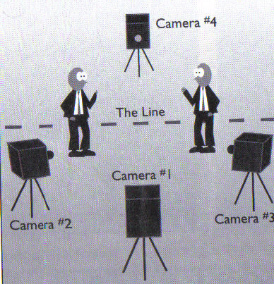
5. The 180 Degree Rule-most important code of continuity editing. Cuts must adhere to the right-left coordinates and remain consistent as long as camera remains on the same side as the line of action.

Slide 25
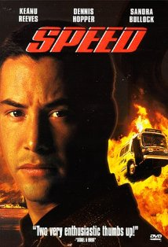
Parallel action-suggesting (simultaneous) parallel action that two or more things are happening at the same time. This enables filmmakers to weave together several lines of action in telling the story.
Cross-cutting-editor goes back and forth, typically with increasing speed, between two or more lines of action.
Speed (1994)

Slide 26
Montage-builds a scene out of many brief shots, producing a fragmentary view of action and locale.
1. Used to fragment time and space (Moulin Rouge)
2. Visually embody thematic or intellectual ideas (thematic montage) Modern Times (1936)

Slide 27
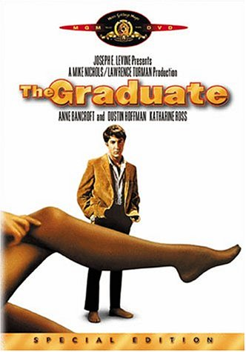
ASSOCIATIONAL MONTAGE
The arrangement of shots is intended by a filmmaker to cue a deliberate set of specific intellectual and emotion associations by the viewer

Slide 28
GRAPHIC MATCH-Two successive shots joined so as to create a strong similarity of compositional elements (e.g., color, shape). MATCH ON ACTION-A cut which splices two different views of the same action together at the same moment in the movement, making it seem to continue uninterrupted.

Slide 29
OVERLAPPING EDITING-cuts that repeat part or all of an action, thus expanding its viewing time and plot duration.

Slide 30
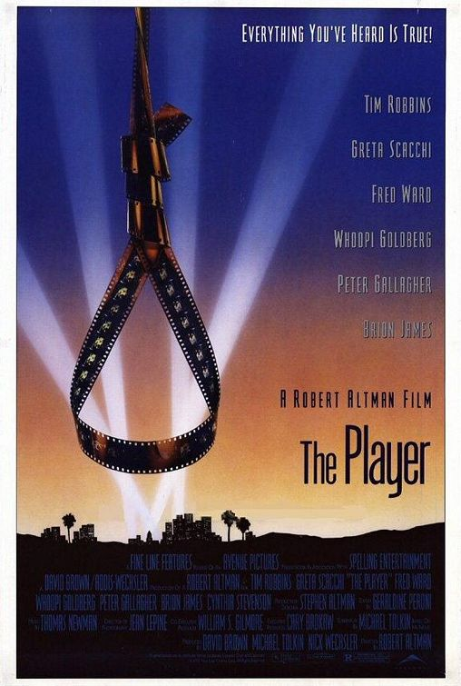
THE LONG TAKE
A shot of very long duration
Think Swingers; The Player; Touch of Evil

Slide 31
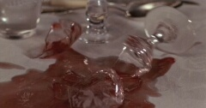
RHYTHM-The perceived rate and regularity of sounds, series of shots, and movements within the shots. It is also one of the most complex to analyze, since it is achieved through the combination of mis-en-scene, cinematography, sound and editing. Indeed, rhythm can be understood as the final balance all of the elements of a film.

Slide 32
Deconstructing Harry (1997)

Slide 33
Cries and Whispers (1972)

Slide 34
The Good, the Bad, and the Ugly (1966)

