Slide 1
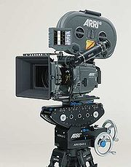
Film Structure and the camera
How position, angle, lens and movement have a major impact on the visual structure of a film

Slide 2
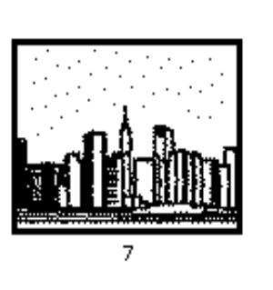
Extreme long shot-A view from a considerable distance; often used to introduce a film or begin a scene (also called an establishing shot)

Slide 3
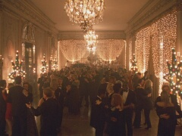
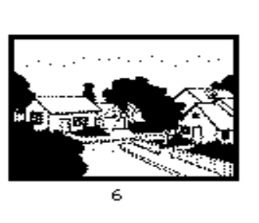
Long shot-A view from a distance, of a large object or a collection of objects. Often used to establish a setting, stress environment, or show a character’s relationship within an environment (establishing shot).

Slide 4
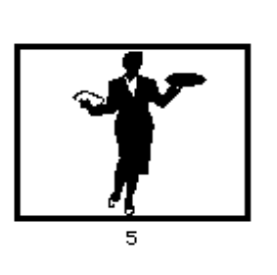
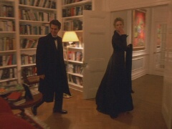
Full shot-A full view of a person

Slide 5
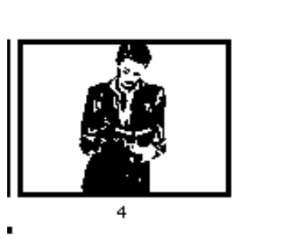
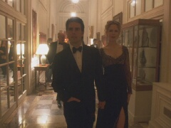
American shot-A three-quarter view of a person, showing her or him from the knees up

Slide 6
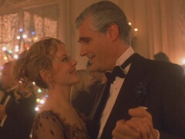
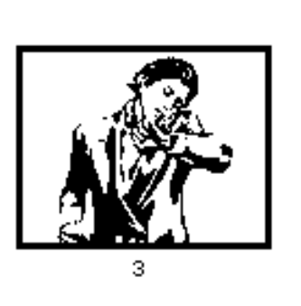
Medium shot-A view of the upper half of a person's body, showing his or her bodily stance; brings characters closer to viewer while still showing environment.

Slide 7
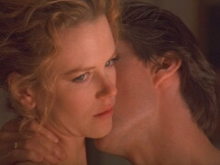
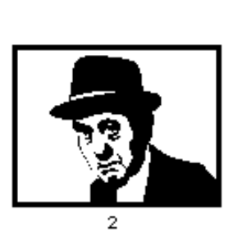
Close-up-Full view of, typically, a human face; stresses characters or objects over surroundings for expressive/dramatic purposes; guides/directs viewer to important features of scene’s action or meaning

Slide 8
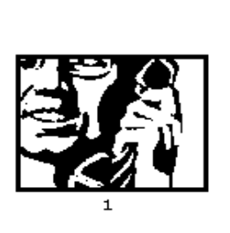
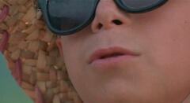
Detail/extreme close-up-A small object or part of an object shown large; stresses characters or objects over surroundings

Slide 9
Camera Position
Helps get into character’s personal space
Manipulates what viewer sees
Effects of camera position are context-dependent
How is position related to dramatic or emotional context of shot and/or scene?

Slide 10
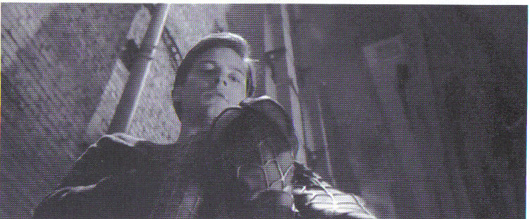
ANGLE OF FRAMING Framing-position of subject in the frame 3 Essential positions low medium (eye-level) high

Slide 11
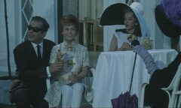
Straight-on angle-the camera is positioned at about the same height as the object, shooting straight and level (this is the default angle).

Slide 12
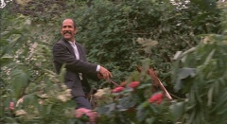
Low angle-The object is seen from a low-level position (camera looking up)

Slide 13
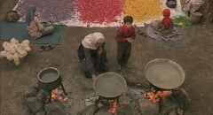
high angle-the object is seen from above (camera looking down). A limit case of the high angle shot is the aerial-shot (a bird's-eye view taken from a helicopter or an airplane).

Slide 14
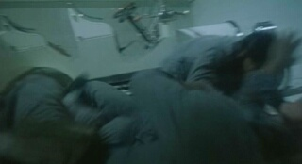
Oblique angle (canted/tilted angle)-The camera is tilted sideways showing a tilted view of an object. May suggest disorientation, anxieties, visualizes emotional/psychological instability

Slide 15
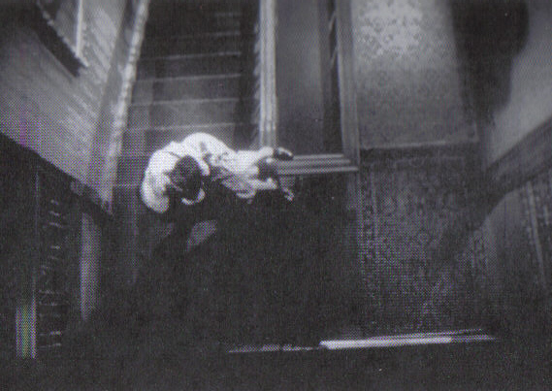
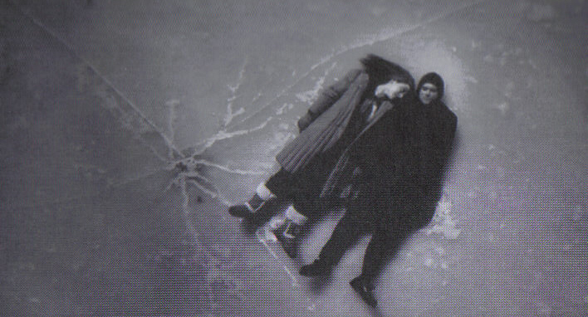
Angle of framing can convey character’s view of the world and accompanying emotions; also can complicate emotional responses by playing against visual relationships viewers want to have with characters

Slide 16
Camera Lens
A lens is a device that gathers light into the camera to a focused point on film, creating an image (emulsion)
Choice of Lens can
Affect apparent size of objects
Affect apparent relationship of depth and distance between far and near objects
type of lens used in each shot helps define relationship between camera and what it photographs.

Slide 17
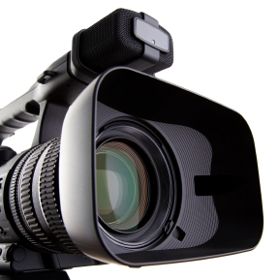
Focal Length/depth of field-distance from the film inside the camera and the optical center.

Slide 18
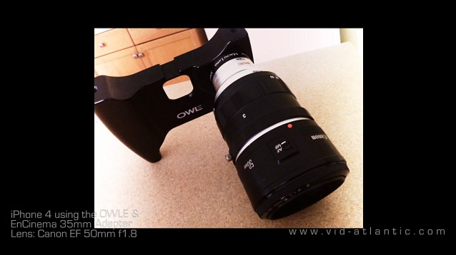
Angle of view-how much the focal length of a lens sees Normal lens-focal length of 50mm for 35mm film is standard

Slide 19
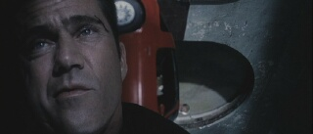
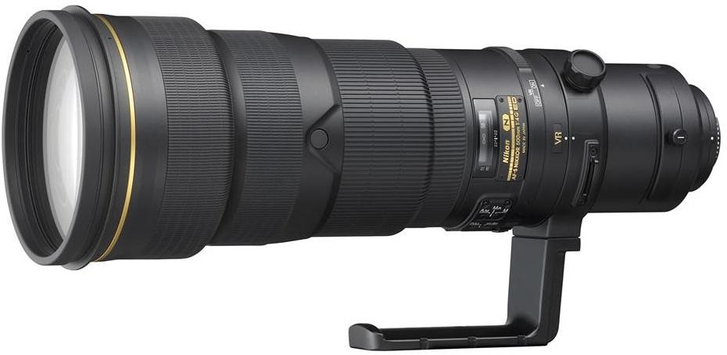
Telephoto lens-greater than normal focal length, more narrow, will magnify distant objects with less depth The effect of using a long lens is to compress the apparent depth of an image, so that elements that are relatively close or far away from the camera seem to lie at approximately the same distance.

Slide 20
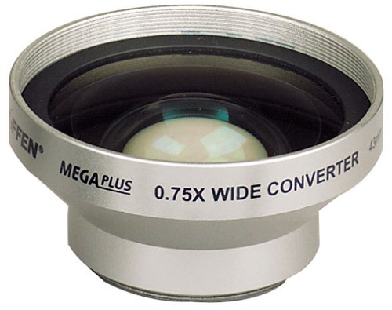
Wide-angle lens-less than normal focal length, shows a greater, wider area while also providing more depth

Slide 21
Zoom-variable focal length, can shift from wide angle to telephoto the frame moves in on or away from an object (zooming in, zooming out)

Slide 22
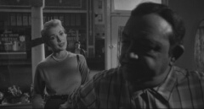
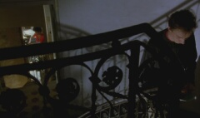
DEEP FOCUS-all planes are in focus and significant to the scene. All elements at very different depths of the image both be in focus.

Slide 23
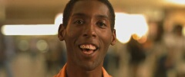
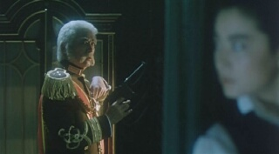
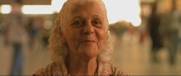
Shallow focus-keeps only one plane in sharp focus; the opposite of deep focus. Used to direct the viewer's attention to one element of a scene
Depth of field-Focusing audience's attention on one sharp plain (background in focus, foreground out of focus)

Slide 24
RACKING FOCUS-Racking focus refers to the practice of changing the focus of a lens such that an element in one plane of the image goes out of focus and an element at another plane in the image comes into focus.

Slide 25
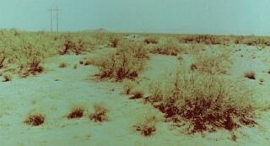
EXPOSURE-A camera lens has an aperture that controls how much light passes through the lens and onto the film.

Slide 26
Camera Movement
There are many ways to move a camera
-in fluid long takes
-rapid and confusing motions that establish the rhythm and point of view of a scene.

Slide 27
Crane shot-camera moves up or down on a crane structure. Used for long and extreme long shots.

Slide 28
Pan-The camera surveys a scene by turning around its vertical or horizontal axis.

Slide 29
TILT-A camera movement with the camera body swiveling upward or downward on a stationary support.

Slide 30
Push in, pull back-the camera moves in on or away from a stationary object. Tracking shot/pulling shot-the camera follows (tracks) or precedes (pulls) an object which is in motion itself. Dolly-rolling platform camera is stationed on

Slide 31
HANDHELD CAMERA, STEADYCAM-The use of the camera operator's body as a camera support, either holding it by hand or using a gyroscopic stabilizer and a harness.

Slide 32
FOLLOWING SHOT-A shot with framing that shifts to keep a moving figure onscreen. A following shot combines a camera movement, like panning, tracking, tilting or craning, with the specific function of directing our attention to a character or object as he/she/it moves inside the frame.

Slide 33
REFRAMING-Short panning or tilting movements to adjust for the figures' movements, keeping them onscreen or centered.

Slide 34
Structural Design and Creative Choice -Where is the camera positioned? -What angle is employed? -Which lens is used and to what effect? -Does the shot/scene employ camera movement?

Slide 35
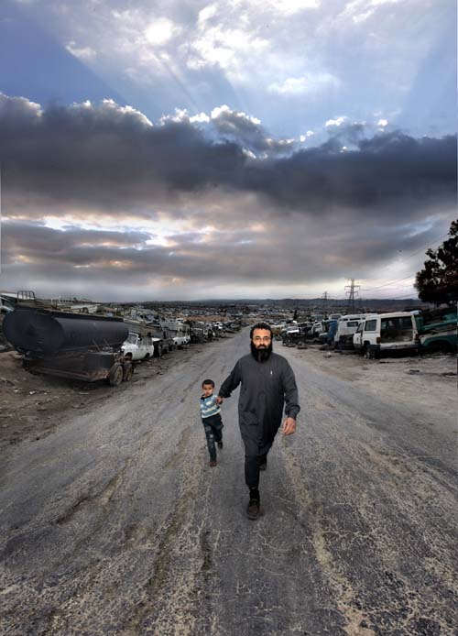
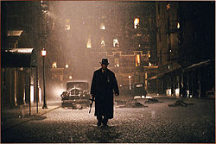
CINEMATOGRAPHY is the making of camera choices when recording photographic images for the cinema. The look of an image, its balance of dark and light, the depth of the space in focus, the relation of background and foreground, etc. all affect the reception of the image.

Slide 36
POINT-OF-VIEW SHOT-A shot taken with the camera placed approximately where the character's eyes would be, showing what the character would see

Slide 37
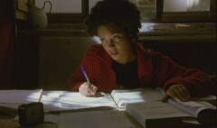
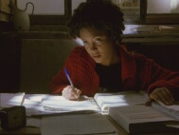
ASPECT RATIO-The ratio of the horizontal to the vertical sides of an image.

